Slide 1


Fuzzy Logic in Expert Systems
This presentation explores fuzzy logic and its applications in expert systems. Fuzzy logic provides a way to reason with uncertain and imprecise information. We will discuss the principles, components, and advantages of fuzzy logic. Finally, we will examine real-world examples of fuzzy logic in various expert systems.
By- G V Rishvanth
Anushka Srivastav

Slide 2
Introduction to Fuzzy Logic
What is Fuzzy Logic?
Fuzzy logic is a form of many-valued logic. It deals with reasoning that is approximate rather than fixed and exact. Unlike classical logic, fuzzy logic allows for partial membership in a set. This contrasts with traditional crisp sets, where an element is either a member or not.
Fuzzy logic is useful for systems with uncertain or ambiguous data. It allows for gradual transitions between true and false, enabling more human-like decisions.

Slide 3

Origin and Concept
Proposed by Lotfi Zadeh (1965)
Fuzzy Sets vs. Crisp Sets
Membership Function
Lotfi Zadeh introduced fuzzy logic to address uncertainty and imprecision.
Fuzzy sets allow partial membership; crisp sets are binary (in or out).
Defines the degree of membership in a fuzzy set (0 to 1).

Slide 4
Fuzzy Logic vs. Classical Logic
Classical Logic
Fuzzy Logic
Based on binary truth values: True or False (1 or 0).
Deals with degrees of truth: values between 0 and 1.
For example, temperature can be classified in degrees of hot, warm, and cold using fuzzy logic. This provides a more nuanced representation than classical logic.

Slide 5

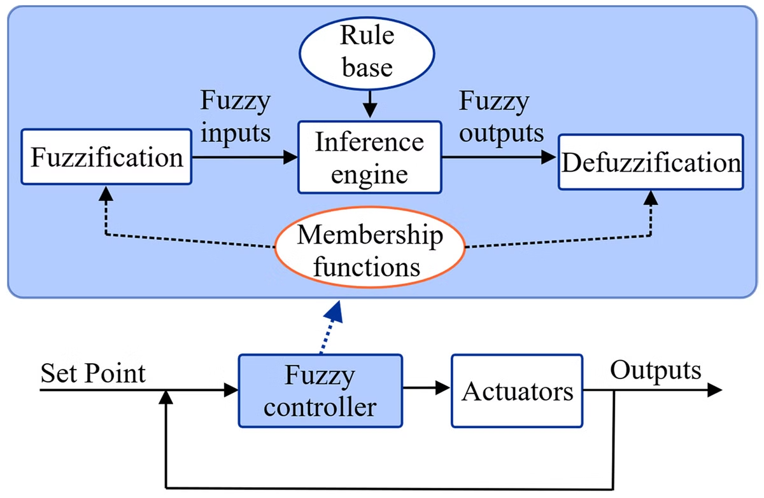


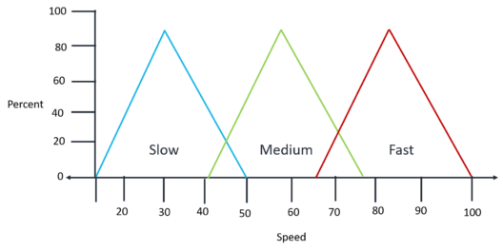


Fuzzy Logic System Components
Fuzzification
Convert crisp inputs into fuzzy values.
Rule Base
Set of IF-THEN rules.
Inference Engine
Apply fuzzy rules to derive conclusions.
Defuzzification
Convert fuzzy outputs into crisp values.

Slide 6

Expert Systems Overview
Definition
Purpose
Computer programs that emulate the decision-making ability of a human expert.
Solve complex problems in a specific domain.
Components
Knowledge Base
Inference Engine
User Interface

Slide 7




Fuzzy Logic in Expert Systems
Uncertainty
1
Reasoning
Handles vague info
2
Rule-based reasoning
Precision
4
Example
3
Avoid rigid conditions
Medical diagnosis
Fuzzy logic helps handle uncertainty and imprecision in expert systems. Fuzzy sets enable rule-based reasoning. For example, in medical diagnosis, fuzzy rules can represent symptoms.

Slide 8
Advantages and Limitations
Advantages
Limitations
Handles vague information
Computational complexity
Mimics human reasoning
Interpretability concerns

Slide 9
Thank you :)

